Slide 1

CC 141 Discrete Structures Department of Computer Science School of Systems and Technology University of Management and Technology Lahore, Pakistan

Slide 2
NESTED QUANTIFIERS
Section 1.5

Slide 3
Nested Quantifiers
Nested Quantifiers
One Quantifier within scope of another Quantifier
Examples:
proposition ∀ y ∃ x (x + y = 1 ) with two quantifiers,
where ∀ y is applied to ∃ x (x + y = 1 ), and ∃ x is applied to x + y = 1

Slide 4
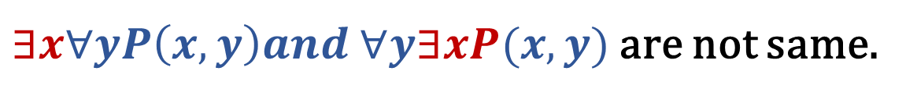
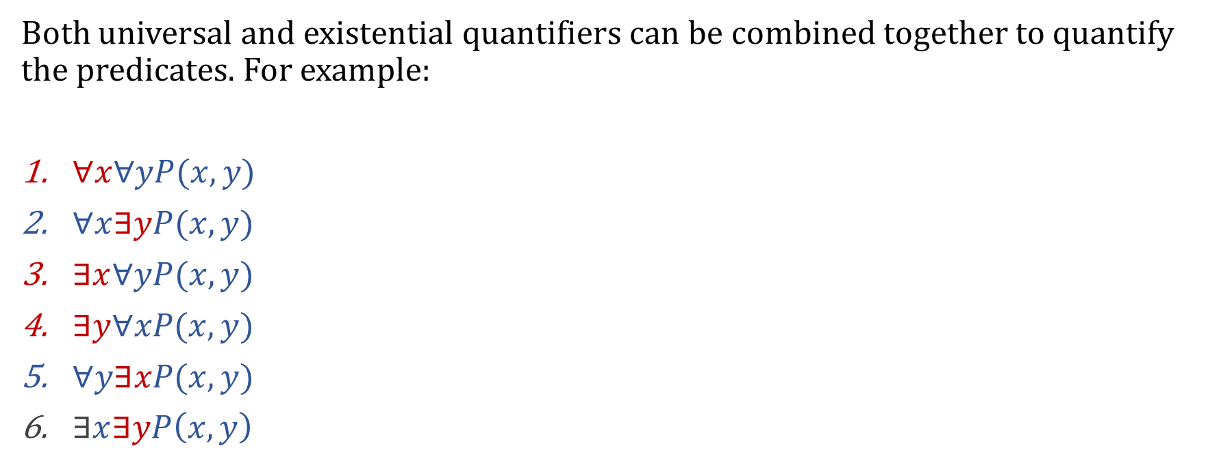
Mixing Quantifiers – Nested Quantifiers
Both universal and existential quantifiers can be combined together to quantify the predicates. For example:
$∀x∀yP(x, y)$
$∀x∃yP(x, y)$
$∃x∀yP(x, y)$
$∃y∀xP(x, y)$
$∀y∃xP(x, y)$
$∃x∃yP\left(x, y\right)$
All six forms are valid.
Be careful while evaluating them, these quantifiers are applied from left to right and their order is important.
$∃x∀yP\left(x, y\right)and ∀y∃xP(x, y)$ are not same.

Slide 5
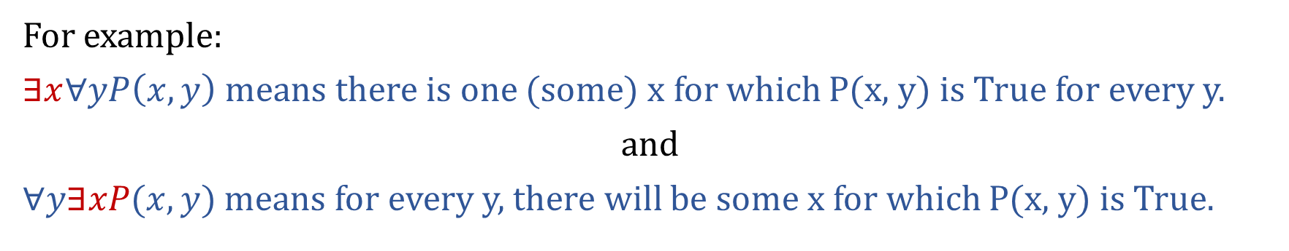
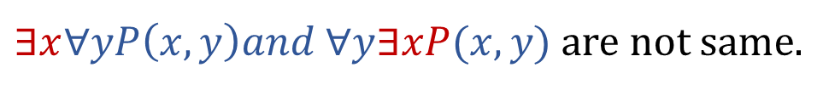
Mixing Quantifiers …
$∃x∀yP\left(x, y\right)and ∀y∃xP(x, y)$ are not same.
For example:
$∃x∀yP\left(x, y\right)$ means there is one (some) x for which P(x, y) is True for every y.
and
$∀y∃xP(x, y)$ means for every y, there will be some x for which P(x, y) is True.
Still confusing?

Slide 6
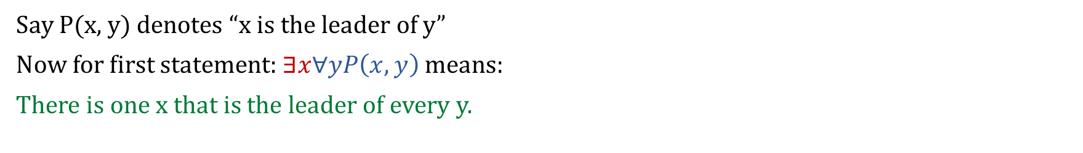
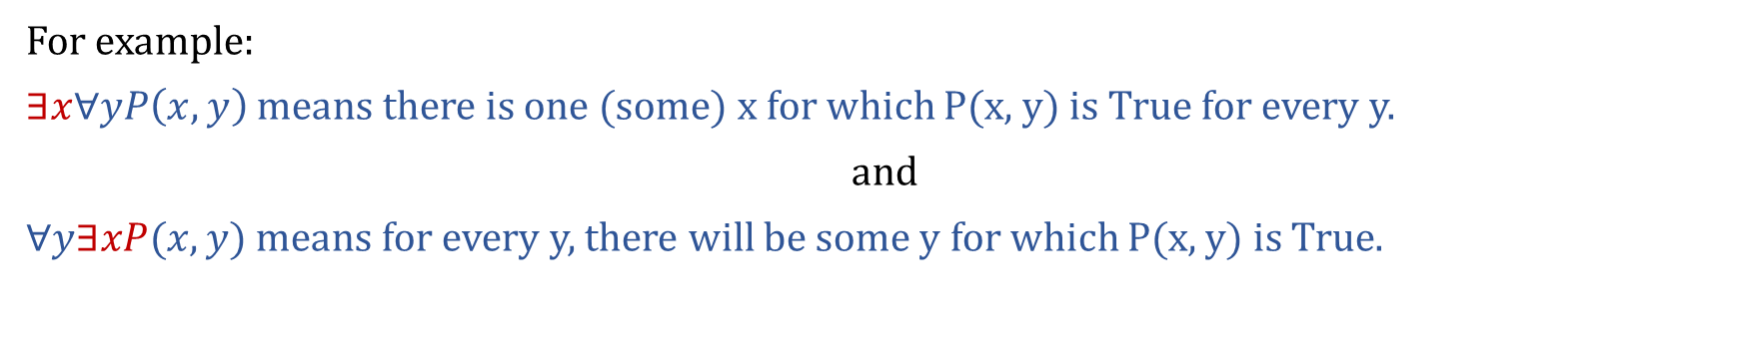
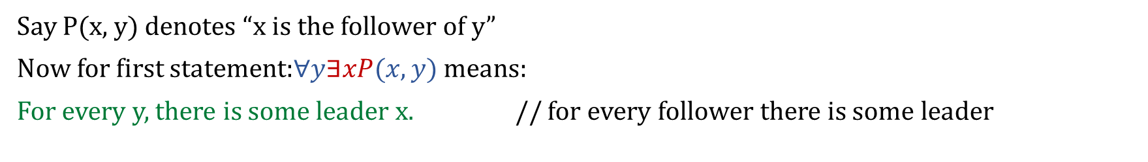
Mixing Quantifiers …
For example:
$∃x∀yP\left(x, y\right)$ means there is one (some) x for which P(x, y) is True for every y.
and
$∀y∃xP(x, y)$ means for every y, there will be some y for which P(x, y) is True.
Say P(x, y) denotes “x is the leader of y”
Now for first statement: $∃x∀yP\left(x, y\right)$ means:
There is one x that is the leader of every y.
Say P(x, y) denotes “x is the follower of y”
Now for first statement:$∀y∃xP(x, y)$ means:
For every y, there is some leader x. // for every follower there is some leader

Slide 7
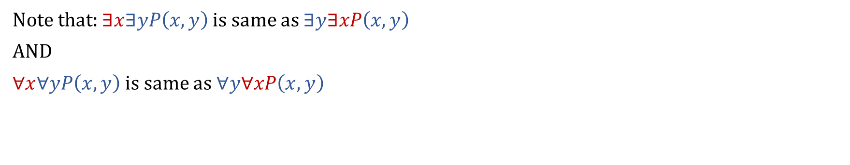
Mixing Quantifiers …
Note that: $∃x∃yP\left(x, y\right)$ is same as $∃y∃xP\left(x, y\right)$
AND
∀$x∀yP\left(x, y\right)$ is same as$∀y\text{∀}xP\left(x, y\right)$

Slide 8
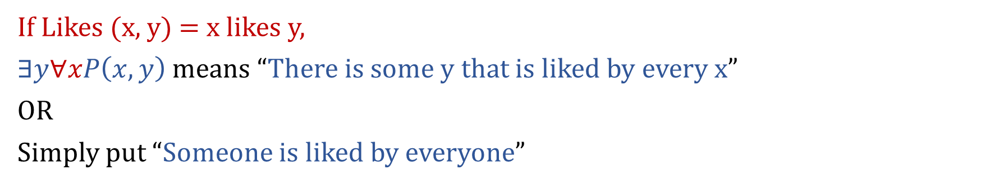
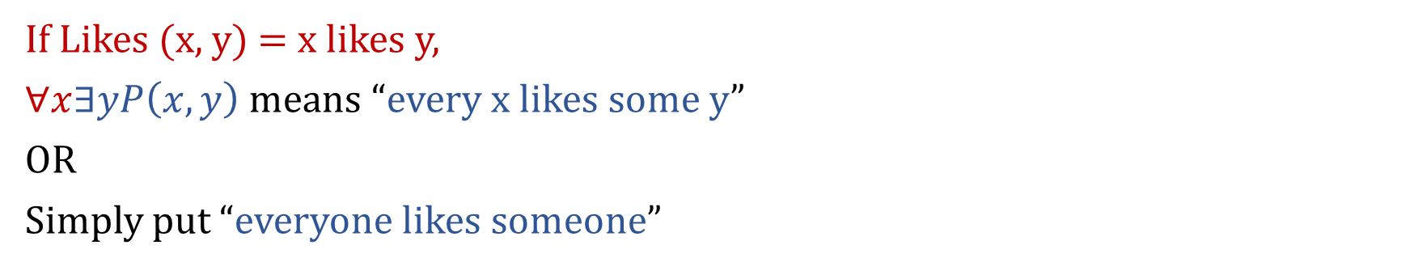
Mixing Quantifiers …
If Likes (x, y) = x likes y,
$∀x∃yP\left(x, y\right)$ means “every x likes some y”
OR
Simply put “everyone likes someone”
If Likes (x, y) = x likes y,
$∃y∀xP\left(x, y\right)$ means “There is some y that is liked by every x”
OR
Simply put “Someone is liked by everyone”

Slide 9
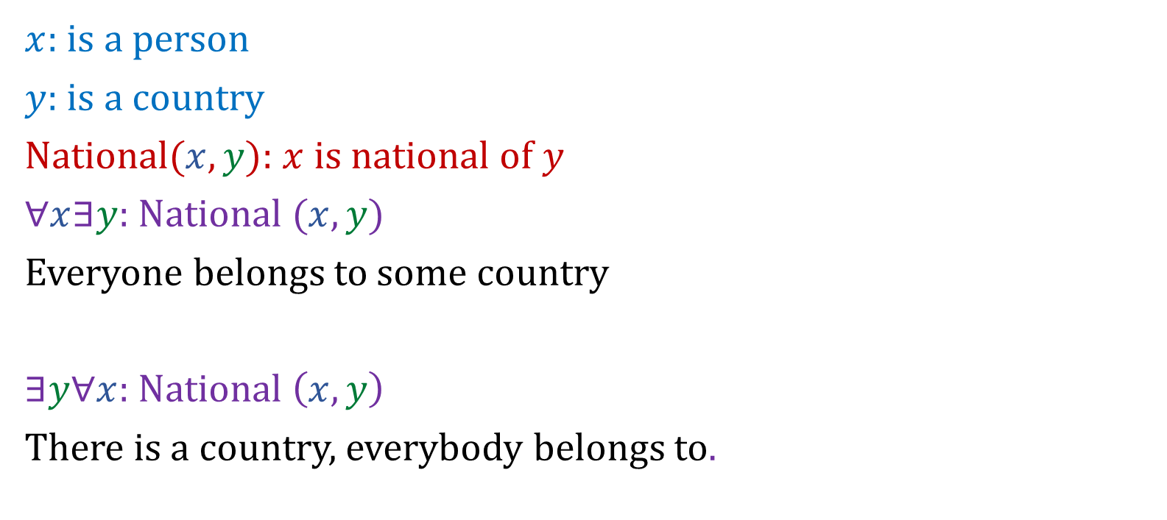
Mixing Quantifiers
$x$: is a person
$y$: is a country
National$(x, y)$: $x$ is national of $y$
$∀x∃y$: National $(x,y)$
Everyone belongs to some country
$∃y∀x$: National $\left(x,y\right)$
There is a country, everybody belongs to.

Slide 10




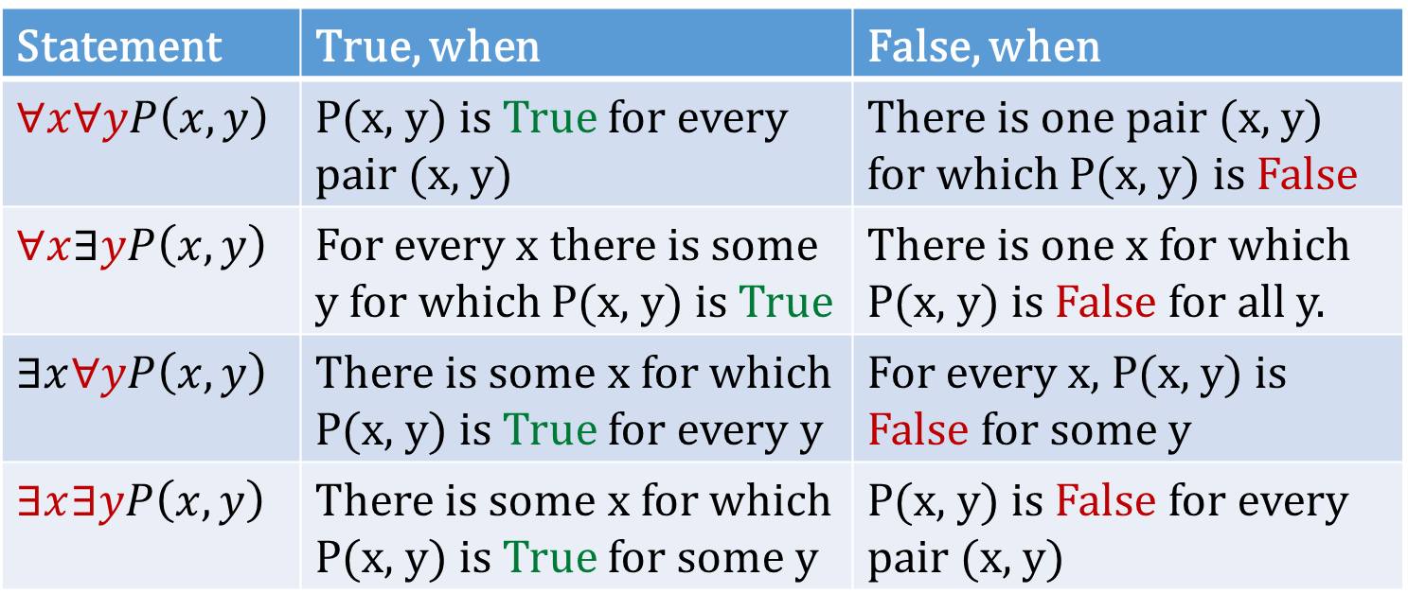
Nested Quantifiers – Truth Values
Negation
Statement | True, when | False, when
$∀x∀yP\left(x, y\right)$ | P(x, y) is True for every pair (x, y) | There is one pair (x, y) for which P(x, y) is False
$∀x∃yP\left(x, y\right)$ | For every x there is some y for which P(x, y) is True | There is one x for which P(x, y) is False for all y.
$∃x∀yP\left(x, y\right)$ | There is some x for which P(x, y) is True for every y | For every x, P(x, y) is False for some y
$∃x∃yP\left(x, y\right)$ | There is some x for which P(x, y) is True for some y | P(x, y) is False for every pair (x, y)

Slide 11
Nested Quantifiers – Loops … ∀x∀yP(x, y)
In working with quantifications of more than one variable, it is sometimes helpful to think in terms of nested loops. For example, to see whether ∀x∀yP(x, y) is True, we loop through the values for x, and for each x we loop through the values for y.
Say X and Y are the sets (arrays) having finite elements:
for (j = 0; j < X.length(); j++) {
for (k = 0; k < Y.length(); k++) {
if (P(x, y) == False ) {
return False
}
}
}
return True;

Slide 12
Nested Quantifiers – Loops … ∃x∃yP(x, y)
In working with quantifications of more than one variable, it is sometimes helpful to think in terms of nested loops. For example, to see whether ∃x∃yP(x, y) is True, we can loop through the values for x, and for each x we loop through the values for y.
Say X and Y are the sets (arrays) having finite elements:
for (j = 0; j < X.length(); j++) {
for (k = 0; k < Y.length(); k++) {
if (P(x, y) == True ) {
return True
}
}
}
return False;

Slide 13
Nested Quantifiers – Loops … ∃x∀yP(x, y)
For example, to see whether ∃x∀yP(x, y) is True, we can loop through the values for x, and for each x we loop through the values for y. Overall result is True if P(x, y) is True for every iteration of internal loop in one iteration of external loop.
Say X and Y are the sets (arrays) having finite elements:
for (j = 0; j < X.length(); j++) {
bool result = True
for (k = 0; k < Y.length(); k++) {
if (P(x, y) == False ) {
result = False; break;
}
}
if (result == True) return True;
}
return False;

Slide 14
Nested Quantifiers – Loops … ∀x∃yP(x, y)
For example, to see whether ∀x∃yP(x, y) is True, we can loop through the values for x, and for each x we loop through the values for y. Overall result is True if P(x, y) is True for one iteration of internal loop in every iteration of external loop.
Say X and Y are the sets (arrays) having finite elements:
for (j = 0; j < X.length(); j++) {
bool result = False
for (k = 0; k < Y.length(); k++) {
if (P(x, y) == True ) {
result = True; break;
}
}
if (result == False) return False;
}
return True;

Slide 15
Translating Mathematical Statements into Logical Expressions
Translate into logical expression:
“The sum of two positive integers is always positive”

Slide 16
Translating Mathematical Statements into Logical Expressions
Translate into logical expression:
“The sum of two positive integers is always positive”
x, y Є Z⁺, ∀x∀y (x + y ≥ 0)

Slide 17
Translating Mathematical Statements into Logical Expressions
Translate into logical expression:
“The subtraction of two positive integers does not always results positive”
x, y Є Z⁺, ∀x∀y ((x - y ≥ 0) ∨ (x - y < 0))

Slide 18
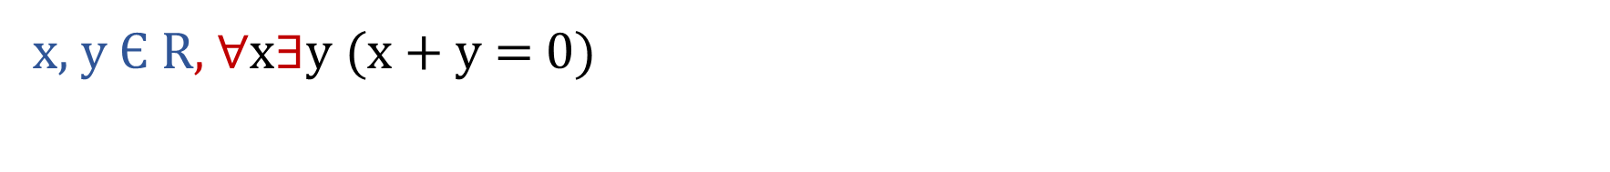
Translating Mathematical Statements into Logical Expressions
Translate into logical expression:
“Every real number has an additive inverse”
x, y Є R, ∀x$∃$y (x + y = 0)

Slide 19
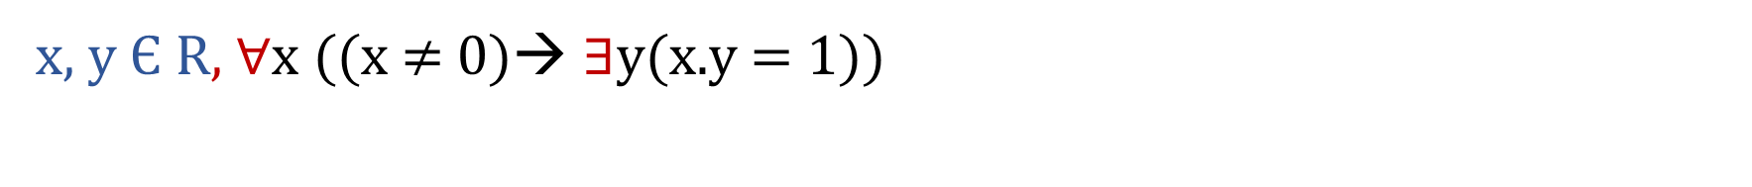
Translating Mathematical Statements into Logical Expressions
Translate into logical expression:
“Every real number except 0 has a multiplicative inverse inverse”
x, y Є R, ∀x ((x ≠ 0)→ $∃$y(x.y = 1))

Slide 20
Translating Logical Expressions into English Statement
Express the mathematical notation ∀x(C(x) ∨ ∃y(C(y) ∧ F(x, y))) into English where:
C(x) = x has a computer
F(x, y) = x and y are friends
The domain of x and y is “all students in the class”.

Slide 21
Translating Logical Expressions into English Statement
Express ∃x∀y∀z((F(x, y) ∧ F(x, z) ∧ (y ≠ z)) → ¬F(y, z)) into English where:
F(x, y) = x and y are friends
The domain of x and y is “all students in the class”.

Slide 22
Translating Logical Expressions into English Statement
Express the following statements into English where domain for each variable is the set of Real Numbers:
∀x∃y(x < y)
∀x∀y∃z(x.y = z)
∀x((x ≠ 0) → ∃y(x.y=1))

Slide 23




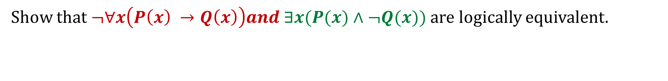
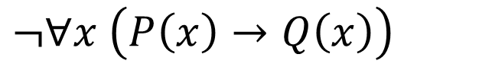
Logical Equivalence
Show that $¬∀x\left(P\left(x\right) →Q\left(x\right)\right)and ∃x(P(x)∧¬Q(x))$ are logically equivalent.
$$¬∀x \left(P\left(x\right)→Q\left(x\right)\right)$$
Using De Morgan’s Law
Proved

Slide 24
Predicates & Quantifiers … Example
Express the statements using predicates and quantifiers “Some student in this class has visited Murree” and “Every student in this class has visited Karachi and Faisalabad”.

Slide 25
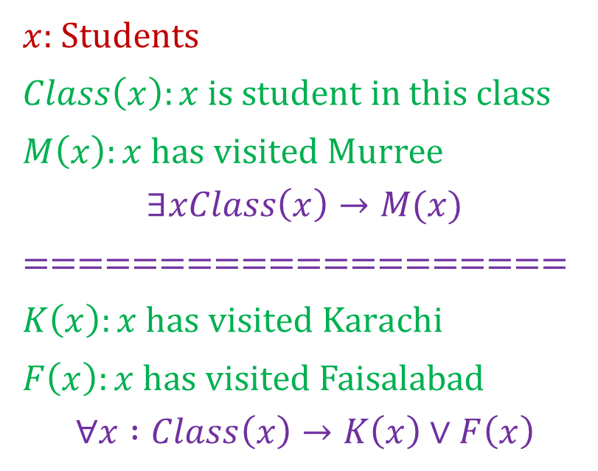
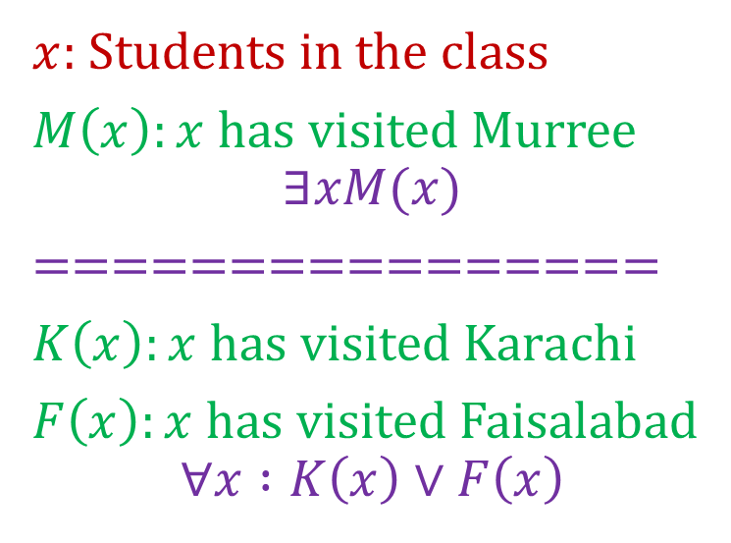
Predicates & Quantifiers … Example
Express the statements “Some student in this class has visited Murree” and “Every student in this class has visited Karachi and Faisalabad”.
$x$: Students in the class
$M\left(x\right):x$ has visited Murree
$$∃xM(x)$$
================
$K\left(x\right):x$ has visited $Karachi$
$F\left(x\right):x$ has visited Faisalabad
$$∀x :K\left(x\right)∨F\left(x\right)$$
$x$: Students
$Class\left(x\right):x$ is student in this class
$M\left(x\right):x$ has visited Murree
$$∃xClass\left(x\right)→M(x)$$
====================
$K\left(x\right):x$ has visited $Karachi$
$F\left(x\right):x$ has visited Faisalabad
$$∀x :Class\left(x\right)→K\left(x\right)∨F\left(x\right)$$

Slide 26
Predicates & Quantifiers … Example
Express the statements using predicates and quantifiers
“Everyone has exactly one best friend”
B(x, y):=“y is the best friend of x”
∀x ∃!y B(x, y)

Slide 27
Predicates & Quantifiers … Example
Express the statements using predicates and quantifiers “Every mail message larger than one megabyte will be compressed” and “If a user is live, at least one network link will be available”.

Slide 28
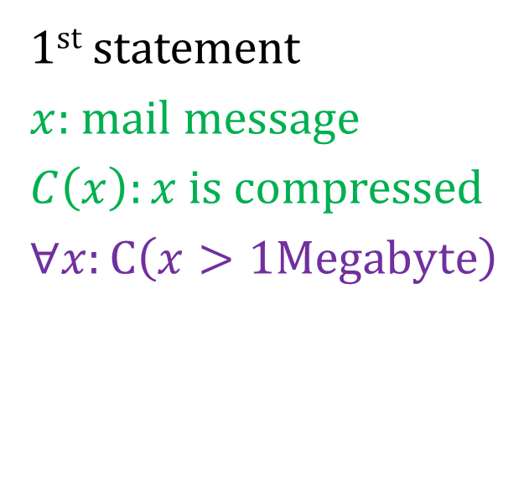
Predicates & Quantifiers … Example
Express the statements using predicates and quantifiers “Every mail message larger than one megabyte will be compressed” and “If a user is active, at least one network link will be available”.
1st statement
$x:$mail message
$C\left(x\right):x$ is compressed
$∀x:C\left(x>1Megabyte\right)$
OR
$∀x>1Megabyte:C\left(x\right)$

Slide 29
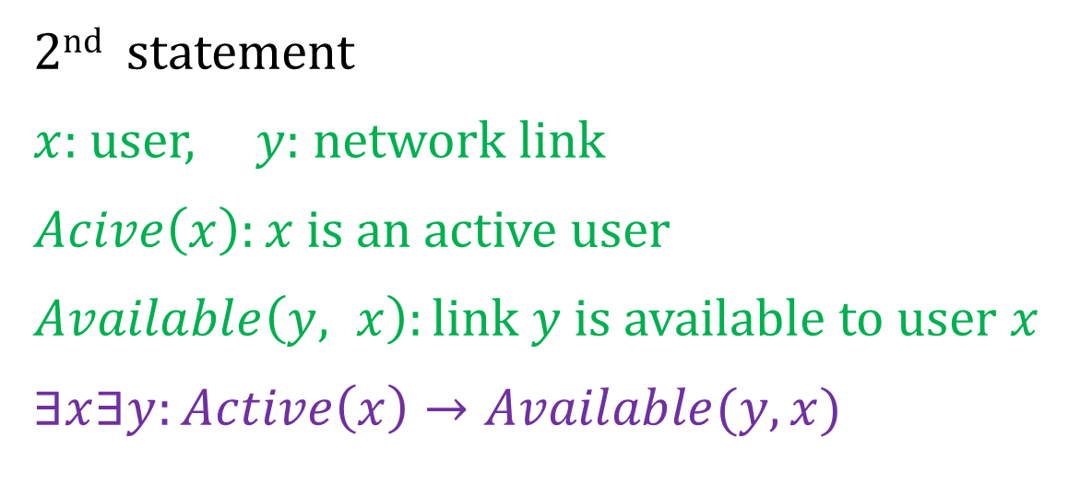
Predicates & Quantifiers … Example
Express the statements using predicates and quantifiers “Every mail message larger than one megabyte will be compressed” and “If a user is active, at least one network link will be available”.
2nd statement
$x:$user, $y:$ network link
$Acive\left(x\right):x$ is an active user
$Available\left(y, x\right):link y$ is available to user $x$
$∃x∃y:Active\left(x\right)→Available(y,x)$

Slide 30
Section 1.5: Nested Quantifiers
Questions for Practice
Exercise 1-20
All Odd Exercises form 21 to 47

Slide 31

Summary
The topics we covered in this section:
Nested Quantifiers
Truth Values of Nested Quantifiers
Negating Nested Quantifiers
Translation English to Logical statements

